Slide 1
MongoDB Advance Concepts
DO NOT WRITE ANYTHING
HERE. LEAVE THIS SPACE FOR
WEBCAM

Slide 2
Agenda
How to perform Aggregation and MapReduce in MongoDB?
How to store unstructured data in MongoDB using GridFS?
Concepts of Replication in MongoDB
Different members in ReplicaSet
Importance of Read Preference, Read and Write Concern
Why to create Sharded Cluster
How to Shard Database and collections
Using PyMongo to perform CRUD Operations
How to perform aggregation, mapReduce using PyMongo?
DO NOT WRITE ANYTHING
HERE. LEAVE THIS SPACE FOR
WEBCAM

Slide 3
Aggregation Operation 1/2
In data aggregation, records are processed, and results are computed.
Data sets in MongoDB can be examined and analyzed with a rich set of aggregation operations.
MongoDB aggregation uses collections of documents as input and returns results as one or more documents.
Data aggregation pipelines are a way to transform documents into aggregated results. The pipeline transforms documents into aggregated results.
During the pipeline stages, filters work like queries and document transformations change the form of the output documents.
DO NOT WRITE ANYTHING
HERE. LEAVE THIS SPACE FOR
WEBCAM

Slide 4
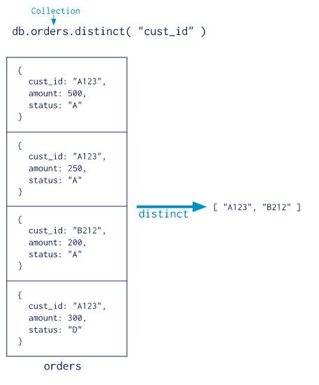
Aggregation Operation 2/2
Furthermore, pipeline stages can use operators to calculate averages or concatenate strings.
DO NOT WRITE ANYTHING
HERE. LEAVE THIS SPACE FOR
WEBCAM
Notes:
Source – https://docs.mongodb.com/manual/images/distinct.bakedsvg.svg

Slide 5
Aggregation pipeline Stages 1/2
Pipeline stages appear in an array. Documents pass through the stages in sequence. All except the $out and $geoNear stages can appear multiple times in a pipeline.
db.collection.aggregate( [ { <stage> }, ... ] )
$project: Specifies which fields to select from a collection.
$match: The amount of documents input into the next stage can be reduced when performing a filtering operation like this.
$group: As discussed above, this performs the actual aggregation.
$sort: It sorts the documents.
DO NOT WRITE ANYTHING
HERE. LEAVE THIS SPACE FOR
WEBCAM

Slide 6
Aggregation pipeline Stages 2/2
$skip: You can skip ahead in the list of documents for a specific number of documents.
$limit: By specifying a number, the amount of documents to be viewed will be limited based on the current position.
$unwind: It is important to rewind documents that are using arrays, since when you use an array, the data is pre-joined, so we must undo that so we can have individual documents again. In turn, this will increase the number of documents for the next process.
DO NOT WRITE ANYTHING
HERE. LEAVE THIS SPACE FOR
WEBCAM

Slide 7
Aggregation pipeline Examples
In the following aggregation operation, all states with populations greater than 10 million are returned:
db.zipcodes.aggregate( [{ $group: { _id: "$state", totalPop: { $sum: "$pop" } } },{ $match: { totalPop: { $gte: 10*1000*1000 } } }] )
The following aggregation operation returns user names sorted by the month they joined. This kind of aggregation could help generate membership renewal notices.
db.users.aggregate([{ $project :{month_joined : { $month : "$joined" },name : "$_id",_id : 0}},{ $sort : { month_joined : 1 } }])
DO NOT WRITE ANYTHING
HERE. LEAVE THIS SPACE FOR
WEBCAM

Slide 8
MapReduce in MongoDB
Data processing paradigm MapReduce condenses data from large volumes into useful aggregate results.
MongoDB provides a mapReduce database command to implement map-reduce operations.
The map phase of the map-reduce operation is applied to each input document (e.g. all documents in the collection matching the query condition).
Key-value pairs are returned by the map function.
During the reduce phase, MongoDB collects and condenses the aggregated data for keys that have multiple values.
Afterwards, MongoDB stores the results in a collection.
DO NOT WRITE ANYTHING
HERE. LEAVE THIS SPACE FOR
WEBCAM

Slide 9
MapReduce - MongoDB
All map-reduce functions run inside the MongoDB process as JavaScript.
Prior to starting the map stage, map-reduce operations can sort and limit the documents of a single collection.
Input and output collections can be sharded, and MapReduce can return a document or a collection as the result of a map-reduce operation.
DO NOT WRITE ANYTHING
HERE. LEAVE THIS SPACE FOR
WEBCAM

Slide 10
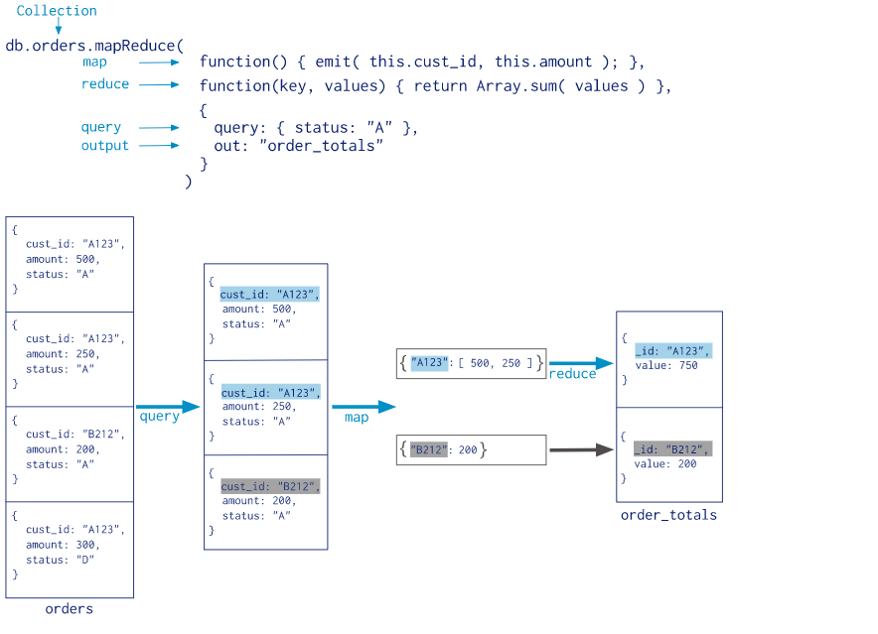
MapReduce Example
DO NOT WRITE ANYTHING
HERE. LEAVE THIS SPACE FOR
WEBCAM
Notes:
Source - https://docs.mongodb.com/manual/core/map-reduce/

Slide 11
GridFS
GridFS is used to store and retrieve files that are larger than the BSON-document size limit of 16MB.
In GridFS, files are broken up into chunks and each chunk is stored as a separate document, rather than as a single document.
You can access a file without having to load the whole file into memory.
GridFS by default limits chunk size to 255k.
To store files, GridFS uses two collections. One collection stores file chunks, and the other stores file metadata.
DO NOT WRITE ANYTHING
HERE. LEAVE THIS SPACE FOR
WEBCAM

Slide 12
GridFS
GridFS clients and drivers reassemble chunks as necessary when they query a GridFS store.
Files stored through GridFS can be accessed through range queries.
In addition, you can access information from arbitrary sections of a file, which allows you to "skip" to a particular point in an audio or video file.
GridFS stores files in two collections “fs.chunks” and “fs.files”
As represented in GridFS, every document represents a distinct chunk of data.
Each chunk is identified by its unique ObjectId stored in its _id field.
DO NOT WRITE ANYTHING
HERE. LEAVE THIS SPACE FOR
WEBCAM

Slide 13
Capped Collection
Fixed-size collections enable high-throughput inserting and retrieving of documents based on insertion order.
As with circular buffers, capped collections work in a similar manner.
In order to make room for new documents, the oldest documents in a collection are overwritten.
A capped collection automatically removes the oldest documents without the need for scripts or explicit removals.
Capped collections guarantee preservation of the insertion order.
Capped collections only allow updates that fit the original document size.
DO NOT WRITE ANYTHING
HERE. LEAVE THIS SPACE FOR
WEBCAM

Slide 14
Capped Collection
db.createCollection( “serverlog", { capped: true, size: 100000 } )
db.createCollection(“serverlog", { capped : true, size : 5242880, max : 5000 } )
Collections that reach the maximum size limit before they reach the maximum number of documents will be removed by MongoDB.
MongoDB guarantees that the results of a find() on a capped collection will be ordered in the order in which they were inserted.
Use find() along with the sort() method with a $natural parameter of -1 in order to retrieve documents in reverse insertion order:
db.cappedCollection.find().sort( { $natural: -1 } )
db.collection.isCapped()
DO NOT WRITE ANYTHING
HERE. LEAVE THIS SPACE FOR
WEBCAM

Slide 15
Storage Engine
Data is stored on disk using a storage engine, a part of a database that manages how data is stored.
Many databases support multiple storage engines.
Different engines perform better for specific workloads.
For example, one storage engine might offer better performance for read-heavy workloads, and another might support a higher-throughput for write operations.
With multiple storage engines, you can decide which storage engine is best for your application.
WiredTiger is the default engine.
MMAPv1 is the default storage engine in previous versions.
DO NOT WRITE ANYTHING
HERE. LEAVE THIS SPACE FOR
WEBCAM

Slide 16
WiredTiger Storage Engine
WiredTiger engine offers additional flexibility and improved throughput for many workloads
WiredTiger excels at read and insert workloads as well as more complex update workloads.
Document Level Locking
With WiredTiger, all write operations happen within the context of a document level lock.
As a result, multiple clients can modify more than one document in a single collection at the same time.
With this very granular concurrency control, MongoDB can more effectively support workloads with read, write and updates as well as high-throughput concurrent workloads.
DO NOT WRITE ANYTHING
HERE. LEAVE THIS SPACE FOR
WEBCAM

Slide 17
Replication in MongoDB
Replication provides redundancy and increases data availability.
Using replication, you can also recover from hardware failure and service interruptions.
Replication can increase read capacity in some cases.
Different servers can be accessed by clients through read and write operations.
Furthermore, you can keep copies of your data at different data centers in order to increase locality and availability.
One of the copies of the data can be dedicated to disaster recovery, reporting, and backup.
DO NOT WRITE ANYTHING
HERE. LEAVE THIS SPACE FOR
WEBCAM

Slide 18
Replication
A replica set is the topology used by MongoDB for database replication.
For redundancy, replica sets duplicate data across multiple machines, which automate failover in the event of server or network failure.
Furthermore, replication allows you to scale database reads. If your application reads heavily, as is commonly the case on the web, you can distribute the reads across multiple machines in the replication cluster.
There are one or more secondary nodes in each replica set.
During a replica set, reads and writes are allowed on the primary node, but only on the secondary node.
DO NOT WRITE ANYTHING
HERE. LEAVE THIS SPACE FOR
WEBCAM

Slide 19
Replication
Primary
Secondary
Secondary
Primary
Secondary
Primary
DO NOT WRITE ANYTHING
HERE. LEAVE THIS SPACE FOR
WEBCAM

Slide 20
Benefits of Replication
Failovers and redundancies
Upgrading and maintaining with zero downtime
Replication master-slave
Solid Consistency
Delay in consistency
Geographical data storage
DO NOT WRITE ANYTHING
HERE. LEAVE THIS SPACE FOR
WEBCAM

Slide 21
Replica Set
There are many mongod instances hosting the same data set in a replica set.
All write operations are handled by one mongod, the primary.
In all other instances, or secondaries, the same operations are applied to the primary data set.
Clients write to the primary. Replica sets can have only one primary.
The replica sets ensure strict consistency between all reads from the primary.
DO NOT WRITE ANYTHING
HERE. LEAVE THIS SPACE FOR
WEBCAM
Notes:
Source- https://docs.mongodb.com/manual/replication/

Slide 22
Replica Set failover
To support replication, Primary records all changes to its data sets in its oplog.rs collection in the local database.
The local database oplog.rs consists of a local replica of the primary's log and an application of the operations to the local log.
Primary operations are applied asynchronously to secondary processes.
When the primary is unavailable, the replica set will choose a secondary to be the primary.
DO NOT WRITE ANYTHING
HERE. LEAVE THIS SPACE FOR
WEBCAM
Notes:
Source-https://docs.mongodb.com/manual/replication/

Slide 23
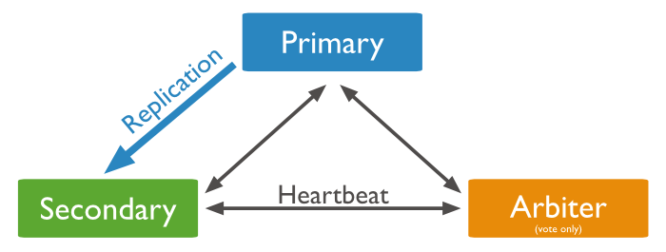
Replica Set Members
MongoDB replica sets are groups of mongod processes that provide high availability and redundancy.
Primary : All write operations are received by the primary.
Secondaries: To maintain the same data set as the primary, secondary servers replicate operations.
DO NOT WRITE ANYTHING
HERE. LEAVE THIS SPACE FOR
WEBCAM
Notes:
Source-https://docs.mongodb.com/manual/replication/

Slide 24
Replica Set Members
Arbiters(Optional): A primary is selected by arbiters if a current primary is unavailable. Arbiters do not keep a copy of the data.
A priority 0 member is a secondary that cannot become primary.
Starting from version 4.4.0 There can be up to 50 members in a replica set, but only 7 members can vote.
DO NOT WRITE ANYTHING
HERE. LEAVE THIS SPACE FOR
WEBCAM
Notes:
Source-https://docs.mongodb.com/manual/replication/

Slide 25
Read Preference
Clients of MongoDB specify the read preference for how read operations are routed to replica sets.
A replica set's read operations are by default directed to the primary member.
In situations where an application does not require fully up-to-date data, you can distribute some or all reads to secondary members of the replica set.
In mongo shell, the readPref() cursor method provide access to read preference
Use mongo.setReadPref() to set read preference.
DO NOT WRITE ANYTHING
HERE. LEAVE THIS SPACE FOR
WEBCAM

Slide 26
Read Preference Modes
primary | Default mode. Read from the primary.
primaryPreferred | Read from the primary but if it is unavailable, operations read from secondary members.
secondary | Read from Secondary
Secondary Preferred | Read from secondary members but if no secondary members are available, operations read from the primary
nearest | Regardless of the type of member, read from the replica set member with the shortest network latency.
DO NOT WRITE ANYTHING
HERE. LEAVE THIS SPACE FOR
WEBCAM

Slide 27
Write Concern
Write concern is a guarantee MongoDB provides when reporting a successful write operation.
Each level of concern determines how strong the guarantee is. A weak write concern allows inserts, updates, and deletes to return quickly.
Occasionally, weak write concerns may prevent write operations from persisting.
After sending a write operation, clients wait for MongoDB to confirm the write operation.
DO NOT WRITE ANYTHING
HERE. LEAVE THIS SPACE FOR
WEBCAM

Slide 28
Write Concern
Different levels of write concern are available in MongoDB to better cater to the specific needs of applications.
In MongoDB, clients can adjust write concern to ensure that the most important operations persist across the entire deployment.
Alternatively, for less critical operations, clients can adjust the write concern to ensure faster performance rather than ensuring persistence for the entire deployment.
DO NOT WRITE ANYTHING
HERE. LEAVE THIS SPACE FOR
WEBCAM

Slide 29
Write Concern Levels
The Specification for write concern:
{ w: <value>, j: <boolean>, wtimeout: <number> }
w Option : “w” requests acknowledgement of propagation of the write operation to a specified number of mongod instances
W Option values:
<number>
"majority"
<custom write concern name>
A write concern can have a timeout threshold:
db.products.insert({ item: "envelopes", qty :100, type: "Clasp" }, { writeConcern: { w: 2, wtimeout: 5000 } })
DO NOT WRITE ANYTHING
HERE. LEAVE THIS SPACE FOR
WEBCAM

Slide 30
Read Concern
Data read from replica sets and replica set shards can be specified in terms of consistency and isolation by using readConcern.
Utilizing write concerns and read concerns effectively can adjust the level of consistency and availability.
DO NOT WRITE ANYTHING
HERE. LEAVE THIS SPACE FOR
WEBCAM

Slide 31
Read Concern
Read Concern Levels :
"local"
"available"
"majority"
"linearizable"
"snapshot“
db.website.find().readConcern('majority')
DO NOT WRITE ANYTHING
HERE. LEAVE THIS SPACE FOR
WEBCAM

Slide 32
Sharding
MongoDB uses Sharding to meet the growing demands for data storage on multiple machines.
As data sizes grow, there may be a limit to how fast a single machine can read and write or how well it can store data.
With sharding, you can scale horizontally.
DO NOT WRITE ANYTHING
HERE. LEAVE THIS SPACE FOR
WEBCAM

Slide 33
Sharding
Sharding allows you to add more machines to address data growth and read/write operation demands.
Shards are independent databases that collectively make up a logical database.
With sharding, data and load are automatically balanced across machines.
By splitting the write load across multiple Mongod instances,
sharding provides additional write capacity.
DO NOT WRITE ANYTHING
HERE. LEAVE THIS SPACE FOR
WEBCAM

Slide 34
Benefits of Sharding
Partition the data
Scaling write throughput
Increases the capacity
Auto-balancing
DO NOT WRITE ANYTHING
HERE. LEAVE THIS SPACE FOR
WEBCAM

Slide 35
When to go for Sharding
Using a sharded cluster is a good idea if:
The amount of data you are storing approaches or exceeds the storage capacity of a single replica set in your system.
Eventually, the active working set of your system will outgrow the maximum amount of RAM.
Your system has a large amount of write activity, a single MongoDB instance cannot write data fast enough to meet demand, and all other approaches have not reduced contention.
DO NOT WRITE ANYTHING
HERE. LEAVE THIS SPACE FOR
WEBCAM

Slide 36
What is Shard?
A given shard holds documents for which the shard key falls within a specific range of values. Shard keys, like indexes, can be either a single field or multiple fields.
Within a shard, MongoDB further partitions documents into chunks. The default chunk size is 64 megabytes
Each chunk represents a smaller range of values within the shard’s range. When a chunk grows beyond the chunk size, Based on the range of the shard key, MongoDB splits the chunk into smaller chunks.
DO NOT WRITE ANYTHING
HERE. LEAVE THIS SPACE FOR
WEBCAM
Notes:
Source- Unknown. Needs to be recreated

Slide 37
What is Shard key?
Within a sharded cluster, you enable sharding on a per-database basis.
After enabling sharding for a database, you choose which collections to shard. For each sharded collection, you specify a shard key.
Shard keys determine the distribution of documents between the shards of the cluster. Each document in the collection contains a shard key field.
MongoDB distributes documents according to ranges of values in the shard key.
DO NOT WRITE ANYTHING
HERE. LEAVE THIS SPACE FOR
WEBCAM

Slide 38
Impact of Shard key?
The selection of the right shard key can make a big difference in the performance, ability, and functionality of your database and cluster.
Your application's query and write patterns will determine the appropriate shard key.
DO NOT WRITE ANYTHING
HERE. LEAVE THIS SPACE FOR
WEBCAM
Notes:
Source- https://docs.mongodb.com/manual/core/sharding-data-partitioning/

Slide 39
Choosing Ideal Shard key?
The ideal shard key:
As a result, MongoDB can easily distribute content between its shards.
As a result, write operations will be distributed across the cluster, so that no single shard becomes a bottleneck.
With MongoDB, the majority of query operations can be performed by a single MongoDB instance.
DO NOT WRITE ANYTHING
HERE. LEAVE THIS SPACE FOR
WEBCAM

Slide 40
Benefit of Shard keys in Cluster Operation?
Write Scaling: The cluster can offer increased write capacity with some shard keys, but others will not.
As a computed shard key with some “randomness”, such as on (i.e. MD5 or SHA1)
A hashed index in MongoDB can be used to shard collections. This can significantly improve read scalability.
DO NOT WRITE ANYTHING
HERE. LEAVE THIS SPACE FOR
WEBCAM

Slide 41
Benefit of Shard keys in Cluster Operation?
Upon receiving a query, the mongod routes it to the mongod instance with the appropriate data based on the metadata in the configuration replica set. The shard key you select can affect the performance of the query.
Query Isolation: In a sharded environment, the fastest queries are those that mongos routes to a single shard using the shard key and cluster metadata from the config server.
DO NOT WRITE ANYTHING
HERE. LEAVE THIS SPACE FOR
WEBCAM

Slide 42
Benefit of Shard keys in Cluster Operation?
When a mongos receives queries from applications, the configuration replica set is used to route queries to mongod instances with the appropriate data. The shard key you select can have an important impact on query performance.
Query Isolation: In a sharded environment, the fastest queries are those that mongos routes to a single shard based on the shard key and cluster metadata on the config server.
DO NOT WRITE ANYTHING
HERE. LEAVE THIS SPACE FOR
WEBCAM

Slide 43
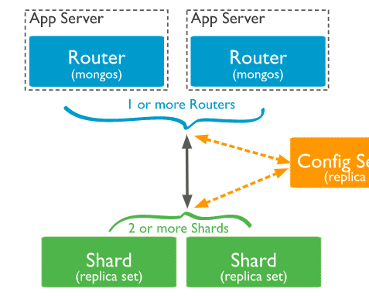
MongoDB Cluster Architecture
ConfigReplicaSet:Primary
ConfigReplicaSet:Secondary
ConfigReplicaSet: Secondary
DO NOT WRITE ANYTHING
HERE. LEAVE THIS SPACE FOR
WEBCAM
Notes:
https://docs.mongodb.com/manual/core/sharded-cluster-components/

Slide 44
MongoDB Cluster Details
Config Replica Set : In the config replica set we should have minimum 3 members.
Separate machines must host each configuration server.
Like any other replica set, config replica set will have primary and secondary's.
Primary will accept the write operation to store the meta data of the cluster.
This meta data will be replicated on the secondary members of the config replica set.
Shards Two or more replica sets: Shards are these replica sets.
Query Routers (mongos) : Cluster routers are Mongos instances. Mongos instances are typically installed on each application server.
DO NOT WRITE ANYTHING
HERE. LEAVE THIS SPACE FOR
WEBCAM

Slide 45
Enable Sharding
Sharding a collection requires enabling sharding for the collection's database.
When a database is sharded, the data is not redistributed, but the collections in that database are sharded.
Connect to the mongos instance from the mongo shell.
mongo --host < mongo machine running hostname > --port <port mongos listens on>
Use the following syntax:
sh.enableSharding("<Database>")
OR db.runCommand( { enableSharding: <Database> } )
DO NOT WRITE ANYTHING
HERE. LEAVE THIS SPACE FOR
WEBCAM

Slide 46
Enable Sharding for a Collection
Sharding is enabled per collection.
Make a choice for the shard key. Your choice of a shard key influences the level of sharding efficiency.
If the collection already contains data, use the createIndex() method to create an index on the shard key.
As part of the sh.shardCollection() method, MongoDB creates the index if the collection is empty.
Using the sh.shardCollection () method in the mongo shell, enable sharding for a collection: sh.shardCollection("<Database>.<Collection>", shard-key-pattern
DO NOT WRITE ANYTHING
HERE. LEAVE THIS SPACE FOR
WEBCAM

Slide 47
Enable Sharding for a Collection
Specifically, replace the <database>.<collection> string with the full database namespace, which includes the database name, a dot (e.g. . ), and the full collection name.
This is the key you specify for your shard, just like you would for an index key pattern.
sh.shardCollection(“census.people", { “pincode": 89, "name": 3 } )
sh.shardCollection("phonebook.contacts", { last_name: “hashed} )
sh.shardCollection("assets.tables", { "type": 2, "_id": 2 } )
sh.shardCollection("economy.car", { "_id": "hashed" } )
DO NOT WRITE ANYTHING
HERE. LEAVE THIS SPACE FOR
WEBCAM
Notes:
Source - https://docs.mongodb.com/manual/reference/method/sh.shardCollection/#mongodb-method-sh.shardCollection

Slide 48

Please Note
In the sharded cluster , applications will connect to MongoS to submit the request.
MongoS will read the meta data from config replica set to understand whether collection is sharded collection or non sharded.
If sharded then it will check the range of shard keys allocated per shard.
Then mongoS will route the write query to the shard which owns the shard key range.
Once data is written to primary of the shard it will be replicated to remaining secondary members.
DO NOT WRITE ANYTHING
HERE. LEAVE THIS SPACE FOR
WEBCAM

Slide 49
A balanced data distribution
Adding new data or adding new servers can lead to data distribution imbalances within a cluster.
Some shards contain significantly more chunks than others or some chunks are significantly larger than others.
Two processes ensure a balanced cluster in MongoDB: splitting and the balancer.
DO NOT WRITE ANYTHING
HERE. LEAVE THIS SPACE FOR
WEBCAM

Slide 50
Splitting 1/2
To prevent chunks from becoming too large, the background process of splitting is used.
A chunk that grows beyond its specified size , A mongos instance splits the chunk in half.
Inserts and updates also triggers splits if chunk grows beyond a specified chunk size.
A split is an efficient meta-data change.
MongoDB does not migrate data or change shards in order to create splits.
DO NOT WRITE ANYTHING
HERE. LEAVE THIS SPACE FOR
WEBCAM

Slide 51
Splitting 2/2
It is possible for splits to lead to an uneven distribution of chunks across the shards. In such cases, mongo instances will initiate migrations to redistribute chunks.
DO NOT WRITE ANYTHING
HERE. LEAVE THIS SPACE FOR
WEBCAM
Notes:
Source- https://docs.mongodb.com/manual/core/sharding-data-partitioning/

Slide 52
Chunk Size
You can increase or reduce the default chunk size(64MB).
Changing the chunk size has its effect on the cluster’s efficiency.
This leads to a more even distribution of data, but at the expense of frequent migrations. This is expensive at the query routing (mongos) layer.
DO NOT WRITE ANYTHING
HERE. LEAVE THIS SPACE FOR
WEBCAM

Slide 53
Chunk Size
This is more efficient both from a networking perspective and from an overhead perspective at the query routing layer.But it may result in an uneven distribution of the workload.
Document migration is affected by the chunk size, which determines how many documents can be migrated per chunk.
Most deployments are offset by a slightly less evenly distributed database as a result of avoiding frequent and potentially spurious migrations.
DO NOT WRITE ANYTHING
HERE. LEAVE THIS SPACE FOR
WEBCAM

Slide 54
Special Chunk Type
Jumbo Chunks A failed split is labeled as jumbo by MongoDB to avoid repeated migration attempts.
Indivisible Chunks: The chunks of data can grow beyond their specified size in some cases, but cannot be split.
Ex, An individual shard key value is represented by a chunk
DO NOT WRITE ANYTHING
HERE. LEAVE THIS SPACE FOR
WEBCAM

Slide 55
Shard Balancer
MongoDB's balancing process is used within a sharded cluster to redistribute data.
In a cluster, the balancer can run on any of the query routers.
MongoDB automatically balances the chunk size of shards when the number of chunks is too high compared to other shards.
Due to the lack of chunks in the new shard, adding a shard to a cluster causes an imbalance. Despite the fact that after MongoDB migrates data to the new shard, it can take some time before the cluster balances.
After all data has been migrated and the meta data has been updated, the balancer can remove the shard safely.
DO NOT WRITE ANYTHING
HERE. LEAVE THIS SPACE FOR
WEBCAM

Slide 56
Shard Balancer
The balancing process attempts to minimize the impact that balancing can have on the cluster, by:
A single chunk of code must be moved at a time.
A balancing round is only triggered when there is a difference in chunk count between the shard with the largest number and the shard with the smallest number.
DO NOT WRITE ANYTHING
HERE. LEAVE THIS SPACE FOR
WEBCAM
Notes:
Source-https://docs.mongodb.com/manual/core/sharding-balancer-administration/

Slide 57
Shard Balancer
You may disable the balancer on a temporary basis for maintenance and limit the window during which it runs to prevent the balancing process from impacting production traffic.
No Chunks | Migration Threshold
< 20 | 2
20-79 | 4
>80 | 8
DO NOT WRITE ANYTHING
HERE. LEAVE THIS SPACE FOR
WEBCAM

Slide 58
What is PyMongo?
PyMongo is a Python distribution containing tools for working with MongoDB,
PyMongo is the recommended way to work with MongoDB from Python.
Installation of PyMongo:
You can install PyMongo 3.3+ by using the following pip command:
“pip install pymongo”
DO NOT WRITE ANYTHING
HERE. LEAVE THIS SPACE FOR
WEBCAM

Slide 59
Making a Connection with MongoClient
import pymongo
from pymongo import MongoClient
client = MongoClient()
OR
client = MongoClient('localhost', 27017)
OR
client = MongoClient('mongodb://localhost:27017/')
DO NOT WRITE ANYTHING
HERE. LEAVE THIS SPACE FOR
WEBCAM

Slide 60
Getting a Database: PyMongo
MongoDB supports multiple independent databases on a single instance.
In MongoClient instances, you use attribute style access when working with PyMongo:
db = client.test_greatlearning
It is possible to access your database using dictionary style access if your database name prevents you from using attribute style access:
db = client['test-greatlearning']
DO NOT WRITE ANYTHING
HERE. LEAVE THIS SPACE FOR
WEBCAM

Slide 61
Getting a Database: PyMongo
Collections work the same way as databases in PyMongo:
collection = db.test_demo
or (using dictionary style access):
collection = db['test-demo']
DO NOT WRITE ANYTHING
HERE. LEAVE THIS SPACE FOR
WEBCAM

Slide 62
Documents in PyMongo
PyMongo stores documents in dictionaries.
Following is an example of how you might describe a blog post using the dictionary:
import datetime
post = {"author": “Gaurav Pandey",
"text": “Welcome to GreatLearning Pymongo post!",
"tags": ["mongodb", "python", "pymongo"],
"date": datetime.datetime.utcnow()}
It will automatically convert Python types (like datetime.datetime instances) to and from BSON types.
DO NOT WRITE ANYTHING
HERE. LEAVE THIS SPACE FOR
WEBCAM
Notes:
Source- https://pymongo.readthedocs.io/en/stable/tutorial.html

Slide 63
Inserting a Documents : PyMongo
The insert_one() method can be used to insert a document into a collection:
>>> display = db.display
>>> display_id = display.insert_one(display).inserted_id
>>> display_id
ObjectId('...’)
In the case that the document does not already contain an "_id" key, a special key, "_id", is automatically added.
A collection's "_id" must be unique.
DO NOT WRITE ANYTHING
HERE. LEAVE THIS SPACE FOR
WEBCAM
Notes:
Source - https://pymongo.readthedocs.io/en/stable/tutorial.html

Slide 64
Fetching a Document using find_one():PyMongo
In MongoDB, find_one() is the simplest query.
In this method, the result is a single document matching a query (or None if none are found).
find_one() also supports querying on specific elements
print.pprint(dispay.find_one({"author": “Gaurav Pandey"}))
DO NOT WRITE ANYTHING
HERE. LEAVE THIS SPACE FOR
WEBCAM

Slide 65
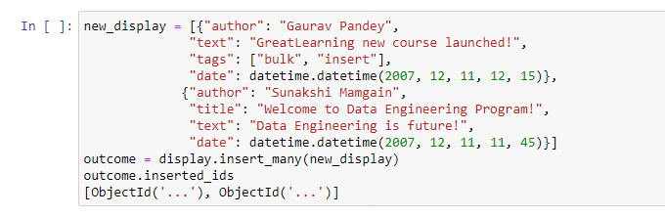
Bulk Inserts using PyMongo
It is also possible to perform bulk inserts by passing a list to insert_many() as the first argument.
A single command will be sent to the server to insert each document in the list.
DO NOT WRITE ANYTHING
HERE. LEAVE THIS SPACE FOR
WEBCAM
Notes:
Source - https://pymongo.readthedocs.io/en/stable/tutorial.html (Changed the values, in pymongo. Done internally).

Slide 66
Fetching more Documents : find() in PyMongo
Using the find() method, multiple documents can be retrieved. The find() method returns an instance of Cursor, which can be used to iterate over all matching documents.
for displays in display.find():
print.print(displays)
DO NOT WRITE ANYTHING
HERE. LEAVE THIS SPACE FOR
WEBCAM

Slide 67
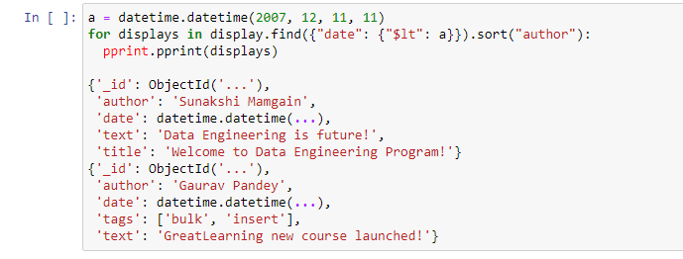
Range Queries : PyMongo
There are many types of advanced queries supported by MongoDB.
For example, let's do a query that limits results to old posts, but sorts them by author.
DO NOT WRITE ANYTHING
HERE. LEAVE THIS SPACE FOR
WEBCAM
Notes:
Source - https://pymongo.readthedocs.io/en/stable/tutorial.html (Changed the values, in pymongo. Done internally).

Slide 68
Indexing using PyMongo
By adding indexes to a database, certain queries are sped up and additional functionality is added to queries and storage.
We can create an index that rejects documents with the same value for a field that already exists in the index.
>>> outcome = db.profiles.create_index([(‘enroll_id', pymongo.ASCENDING)],unique=True)
>>> sorted(list(db.profiles.index_information()))
DO NOT WRITE ANYTHING
HERE. LEAVE THIS SPACE FOR
WEBCAM
Notes:
Source - https://pymongo.readthedocs.io/en/stable/tutorial.html

Slide 69
Aggregation using PyMongo
We can perform a simple aggregation on the tags array to count the number of times each tag appears.
Three operations need to be added to the pipeline in order to achieve this.
Unwinding the tags array is the first step, followed by grouping them by tags and summing them up. Sorting by count is the final step.
You should use SON or collections.OrderedDict since Python dictionaries do not maintain order.
DO NOT WRITE ANYTHING
HERE. LEAVE THIS SPACE FOR
WEBCAM

Slide 70
Aggregation using PyMongo
from bson.son import SON
pipeline = [ {"$unwind": "$tags"},
{"$group": {"_id": "$tags", "count": {"$sum": 1}}},
{"$sort": SON([("count", -1), ("_id", -1)])}
]
DO NOT WRITE ANYTHING
HERE. LEAVE THIS SPACE FOR
WEBCAM

Slide 71
MapReduce - PyMongo
MapReduce is another option for aggregation. Across the entire collection, we will use it to count the number of instances of each tag in the tags array.
DO NOT WRITE ANYTHING
HERE. LEAVE THIS SPACE FOR
WEBCAM

Slide 72
Map Function - PyMongo
For every tag in the array, we emit the pair (key, 1):
from bson.code import Code
mapper = Code("""
function () {
this.tags.forEach(function(z) {
emit(z, 1);
});
} """)
DO NOT WRITE ANYTHING
HERE. LEAVE THIS SPACE FOR
WEBCAM

Slide 73
Reduce Function - PyMongo
When a key is given, the reduce function sums all its emitted values
reducer = Code("""
function (key, values) {
var total = 0;
for (var i = 0; i < values.length; i++) {
total += values[i];
}
return total; } """)
DO NOT WRITE ANYTHING
HERE. LEAVE THIS SPACE FOR
WEBCAM

Slide 74
Performing MapReduce
In the final step, map_reduce() is called and the result collection is iterated over:
result = db.things.map_reduce(mapper, reducer, "myresults")
for doc in result.find().sort("_id"):
pprint.pprint(doc)
DO NOT WRITE ANYTHING
HERE. LEAVE THIS SPACE FOR
WEBCAM

Slide 75

Did You Know?
MongoDB is the number one NoSQL database in terms of deployment.
MongDB is constantly ranged among top 5 databases in the last 3 years
https://db-engines.com/en/ranking_trend/system/MongoDB.
DO NOT WRITE ANYTHING
HERE. LEAVE THIS SPACE FOR
WEBCAM

Slide 76
Summary
In these slides, you will find all the necessary information about PyMongo - a distribution for Python containing tools to work with MongoDB. Python's PyMongo is the most recommended way to interact with MongoDB.
DO NOT WRITE ANYTHING
HERE. LEAVE THIS SPACE FOR
WEBCAM

Slide 77
Thank You
DO NOT WRITE ANYTHING
HERE. LEAVE THIS SPACE FOR
WEBCAM

